Slide 1

Leaders & Heroes
People who made a difference
Lecture # 6 Captains of Industry

Slide 2
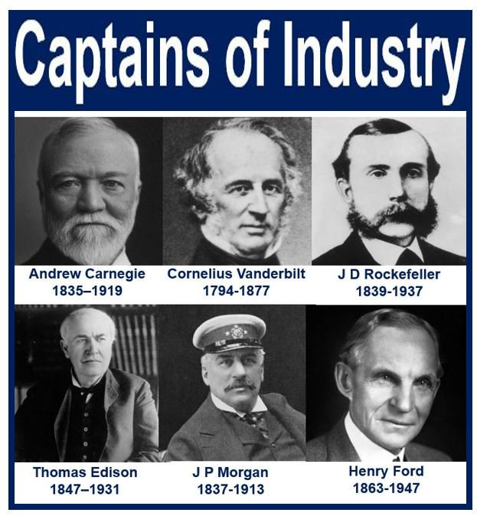
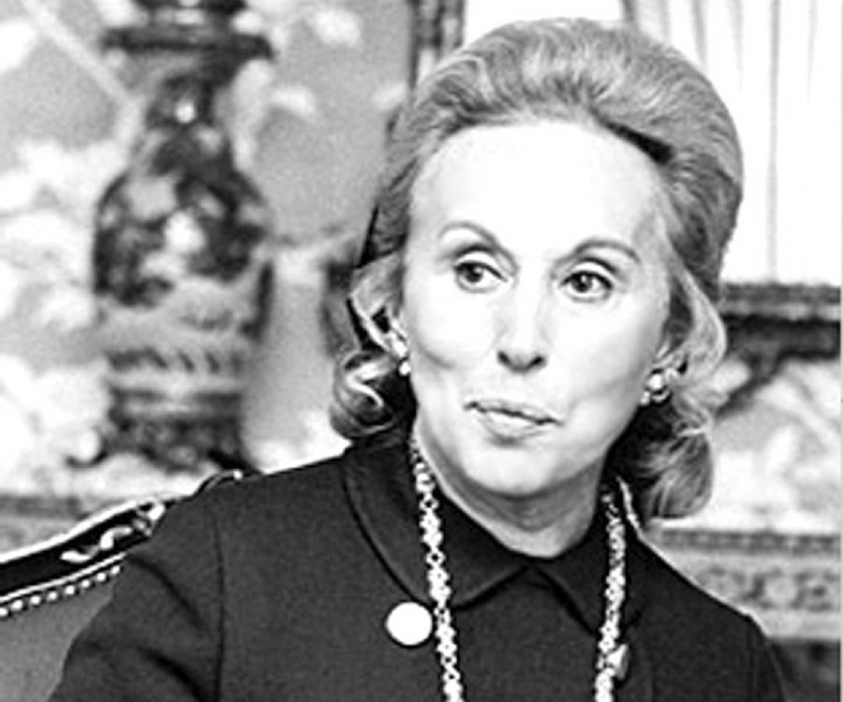

Slide 3





Slide 4


Slide 5
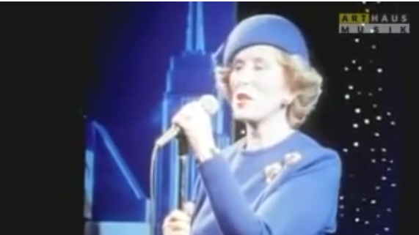
In Her Own Words

Slide 6
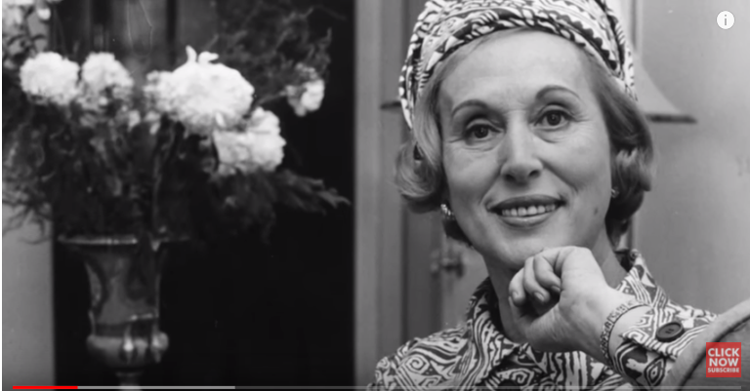
Be Creative From Estee’ Lauder

Slide 7


Slide 8
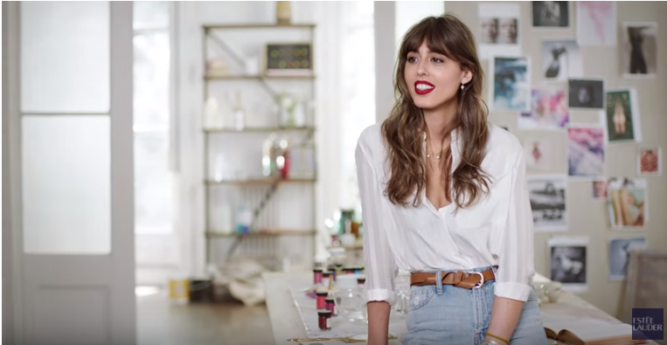
The Brand and the Legacy Moves On with the Times

Slide 9
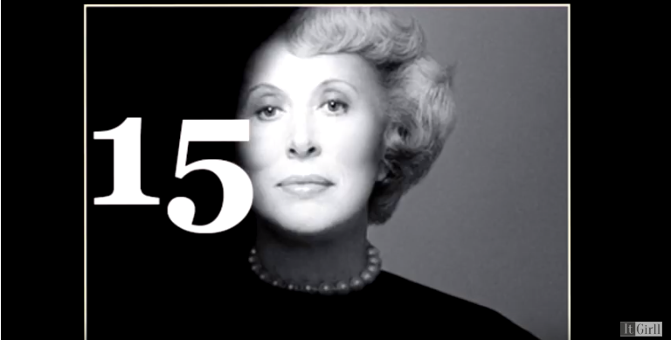
Things you didn’t know about Estee Lauder

Slide 10
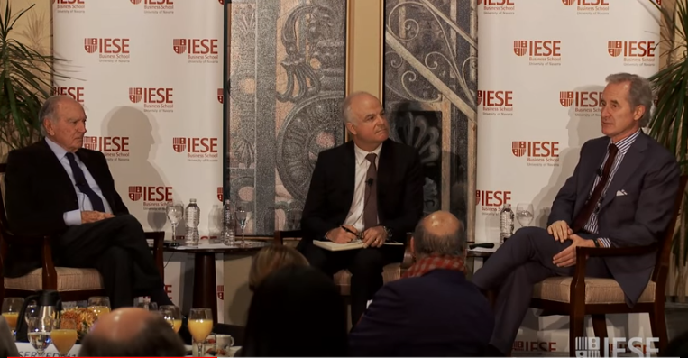
A Family Business

Slide 11
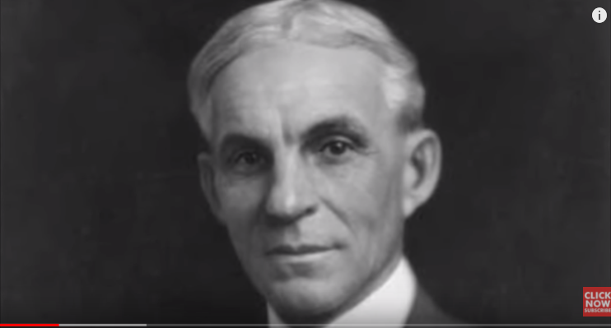
Henry Ford

Slide 12


Slide 13
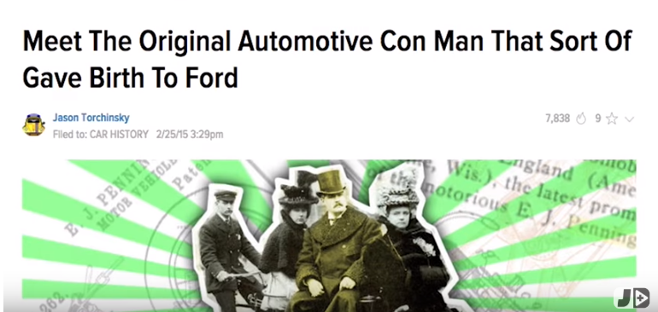

Slide 14
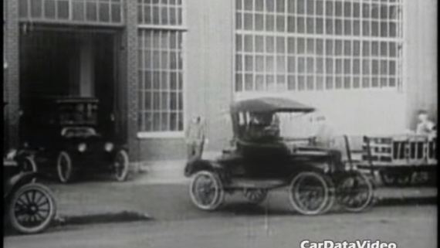
The Revolutionary Model T

Slide 15
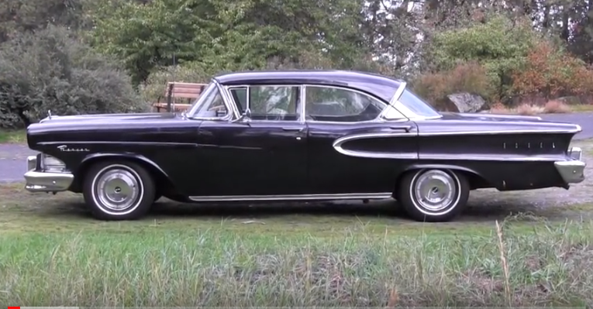

Slide 16
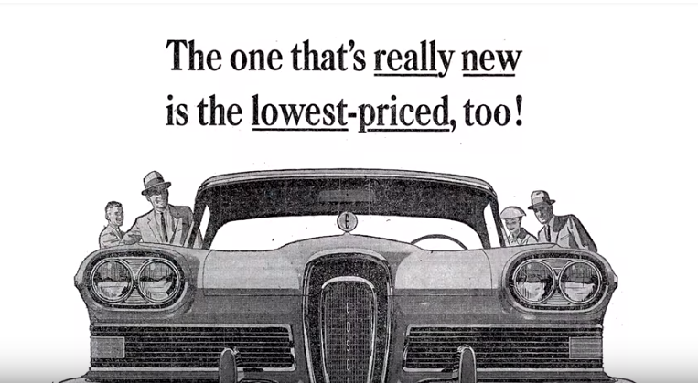

Slide 17


